Slide 1
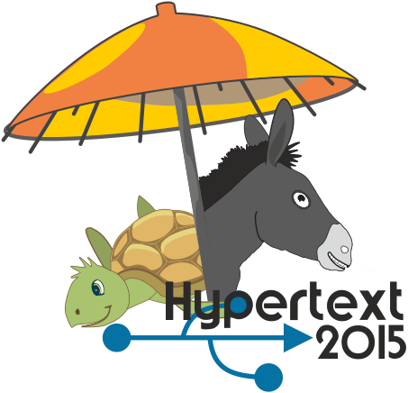


Cultures in Community Question Answering
Imrul Kayes
USF
Nicolas Kourtellis
Telefonica Research
Daniele Quercia,
Francesco Bonchi
Yahoo Labs
Adriana Iamnitchi
USF

Slide 2
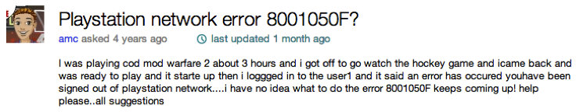
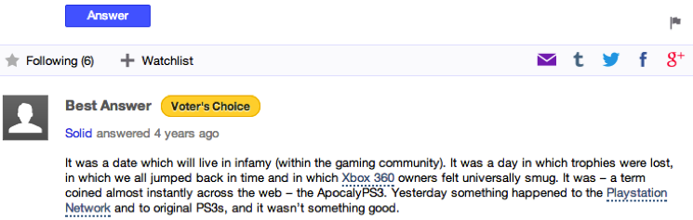
Community Question Answering (CQA)

Slide 3
CQA Platforms
CQA sites: Popular platforms
Yahoo Answers (YA): 200M users, 5M users/day
Quora: 1M/month
Stack Exchange: 4M users (e.g., Stack Overflow)
Functionalities:
Q/A posts & comments, social networking, leaderboards, and more.
Why do we need them?
Not all web-searches are successful!
Complicated / intricate questions!
Notes:
68 % of google searches were successful (2011)
80% for Bing and Yahoo (2011)
2% on Yahoo lead to posts on YA.

Slide 4
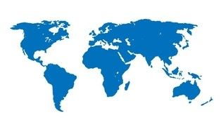
Motivating Question
Does national culture influence how users participate in online CQA platforms?
Notes:
To the best of our knowledge, we are the first to study cultural dimensions in CQAs and how they associate with user asking and answering, abuse reporting.

Slide 5
Main Idea
Analyze participation on YA per country
Compute (or use) cultural indices of each country
Associate YA user participation attributes with cultural indices and extract lessons

Slide 6
Outline
CQA platforms
Motivation
Main idea
Yahoo Answers Dataset
Study on Levin’s Pace of Life
Study on Hofstede’s Cultural Dimensions:
Individualism vs. Collectivism
Uncertainty Avoidance
Power Distance Index
Proposals for CQA platforms improvements

Slide 7
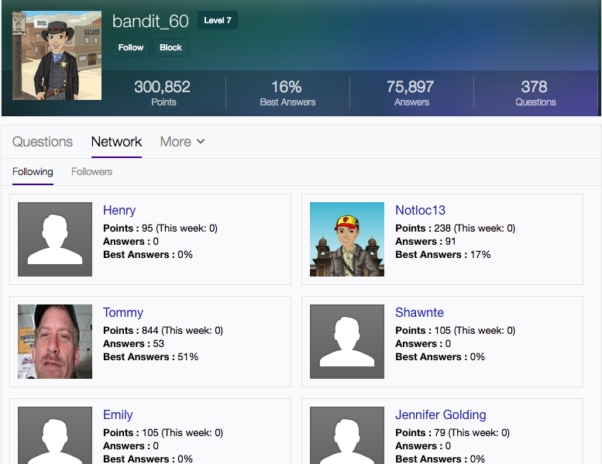
Yahoo Answers Dataset
200k users
490k follow edges
SN properties*
9M questions
43M answers
4.5M abuse reports
(flags)
67 countries => 41 top activity countries
*Kayes et al. “The social world of content abusers in Community Question Answering“, WWW’2015

Slide 8
Sampled users: a representative sample

Slide 9
Selecting Countries
Pick the top 41 countries with:
high correlation of #YA users vs. Internet users
≥ 150 users per country

Slide 10

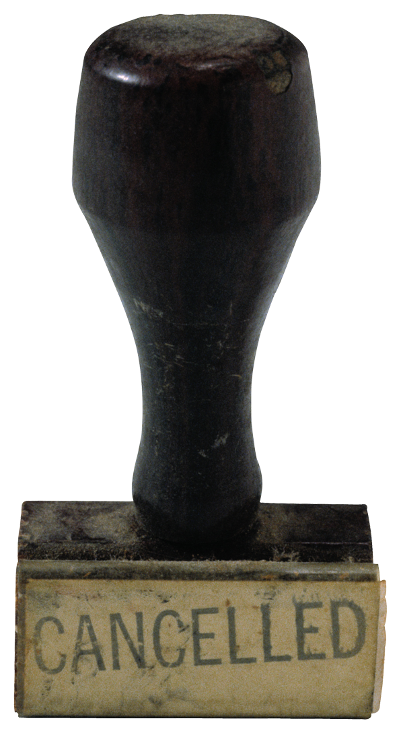
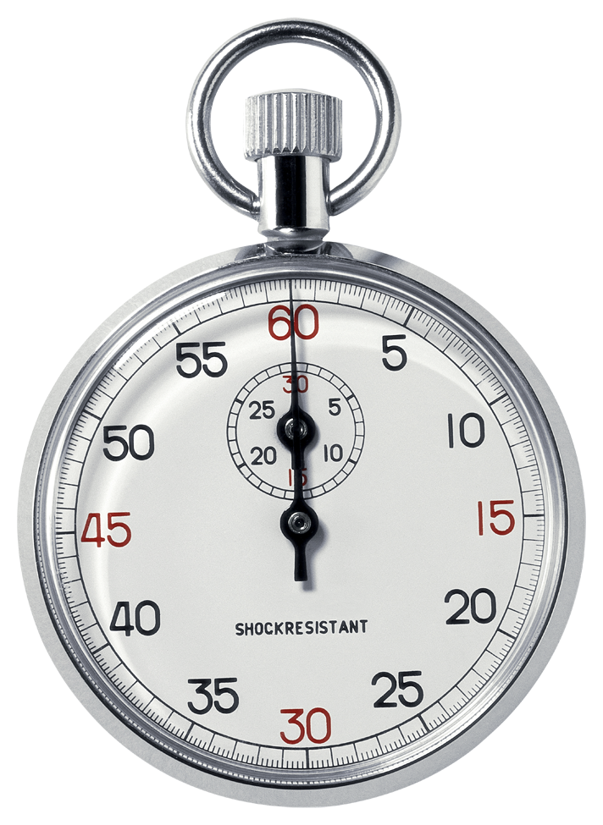
Levine’s Pace of Life
“The flow/movement of time that people experience”
Measured three time indicators in 31 countries:
Walking speed
Postal speed
Clock accuracy
Combined the 3 scores into a country-specific score
Notes:
Proposed by psychologist Robert Levine
Walking speed (60ft)
Postal speed (1 stamp + change)
Clock accuracy (between 15 bank clocks and telephone company)

Slide 11

Pace of Life in Yahoo Answers
Higher Pace of Life Countries expected to have:
Faster life with more rigid perception of time
Planned and organized daily activities
Maybe they are less likely to ask or answer questions in busy hours
[H1]:
Users from countries with a higher Pace of Life score show more temporally predictable activities

Slide 12
Predictability of activities in time
5 time intervals (I) & compute p(c):
Compute Entropy of user u, given all activities:
Entropy_{q/a/r,j}: geometric mean entropy for country j
6:00-8:59 | 9:00-17:59 | 18:00-20:59 | 21:00-23:59 | 00:00-05:59
Morning | Office time | Evening | Late night | Sleeping
p(c=1) | p(c=2) | p(c=3) | p(c=4) | p(c=5)
|U_{j}|
j
j

Slide 13
Predictability of activities in time
Users from Higher Pace of Life countries show more temporally predictable Q & A behavior in YA
Not stat. significant for abuse reporting

Slide 14
Hofstede’s Cultural Dimensions
Based on survey of IBM employees (‘60-’70s), 40 countries
6 dimensions (we study 3)
Individualism vs. Collectivism <=
Uncertainty Avoidance
Power Distance Index
Masculinity vs. Femininity
Long-term vs. Short term orientation
Indulgence vs. Restraint

Slide 15
Individualism in Yahoo Answers
Integration of individuals in a group
Higher individualism countries
Emphasis on personal achievements & rights
Less group harmony and loyalty
Study 3 aspects of individualism in YA:
Individualism vs. contribution
Individualism vs. (un)ethical behavior
Individualism vs. privacy concerns

Slide 16

Individualism & Contribution
People from collectivist countries:
Spend less time on the Internet
More time in socialization
[H2]:
Users from countries with higher individualism index provide more answers
[H3]:
Users from countries with higher individualism index contribute more to the community than what they take away from the community
Notes:
(Mooij, 2005)

Slide 17
Individualism vs. Contribution
Higher Individualism index => more answers
Pearson Correlation r = 0.46, p < 0.005
Notes:
Geometric mean of answers posted by users from a country vs. country’s individualism index
Exclude users with no answers

Slide 18
Yielding score

Slide 19
Individualism vs. Yielding
Higher Individualism index => higher yielding
Pearson r = 0.37, p < 0.05

Slide 20


Individualism vs. (un)ethical behavior
More collectivist countries:
More software and music piracy
More offline world corruption
[H4]:
Users from more collective cultures have higher probability to violate CQA norms
Notes:
Husted, 2000, Ki et al. , 2006, Triandis et al., 2006

Slide 21
Individualism vs. (un)ethical behavior
Higher Collectivist index => more probable to violate community rules
Pearson r = -0.48, p < 0.05

Slide 22
Individualism vs. Privacy Concerns
Higher individualism hints to more privacy concerns
[H5]:
Users from higher individualism index countries exhibit higher level of concern about their privacy.
Notes:
Cho et al. 2009

Slide 23
Individualism vs. Privacy Concerns
Users with ≥ 10 Q/A (79%)
Modifications of privacy settings as a proxy of privacy concerns (more public profiles=>less privacy concerns)*
*More on privacy: Kayes et al. “Privacy Concerns vs. User Behavior in Community Question Answering“, ASONAM’15.
Notes:
Country ranks are based on the percentage of public privacy settings and they are separately done for collectivist and individualistic countries.

Slide 24
Individualism vs. Privacy Concerns
Higher Collectivist index => more probable to find public profiles

Slide 25
Individualism vs. Power Distance
PDI: the extent to which the less powerful members of a society expect and accept that power is distributed unequally
Measures the distribution of wealth and power between people
Indegree imbalance: Avg_Friend_InDegree-User_InDegree
[H6]:
Users from higher power distance countries show a larger indegree imbalance in follow relationships

Slide 26
Individualism vs. Power Distance
Higher Power Distance=>Higher Indegree Imbalance
Pearson r = 0.65, p < 0.005
Confirmation of the friendship paradox
Notes:
The friendship paradox has been shown in Facebook and Twitter

Slide 27
Individualism vs. Uncertainty Avoidance
Uncertainty Avoidance: the extent to which people feel uncomfortable with uncertainty & ambiguity
Higher uncertainty avoidance countries:
Minimize uncertainty & ambiguity by careful planning
Planned and organized daily activities
Enforce rules and regulations
[H7]:
Users from countries with higher uncertainty avoidance index exhibit more temporally predictable activities.

Slide 28
Uncertainty Avoidance vs. Activity
Higher UAI users => lower Q, A, R entropies=> more temporarily predictable activities
Notes:
higher UAI means lower uncertainty and ambiguity

Slide 29
Summary
Analyzed YA activities of 200k users, 67 countries
Studied cultural indices from Hofstede’s dimensions and Levine’s Pace of Life
YA: not a platform of homogeneous culture
National cultures differ in YA:
Temporal predictability of activities
Contribution-related behavior
Privacy concerns
Power inequality
Cultural variations can be used for better CQA platforms

Slide 30
Suggestions to CQA platforms
Culture-aware CQA moderation
In collective cultures: More moderators are needed
Question recommendation
In collective cultures: Questions should be routed to more users
In higher Pace of Life countries: Questions should be routed to more and diverse users in busy hours, or lower Pace of Life countries
Follow recommendation
In lower PDI countries: Recommend similar indegree users
Targeted Ads
In individualistic cultures: focus on ‘I’ and ‘me’, textual, informative ads
In collective cultures: focus on ‘us’ and ‘we’, visual, symbolic ads

Slide 31
Cultures in Community Question Answering
Imrul Kayes
USF
Nicolas Kourtellis
Telefonica Research
Daniele Quercia,
Francesco Bonchi
Yahoo Labs
Adriana Iamnitchi
USF
Paper: http://arxiv.org/abs/1508.05044
nicolas.kourtellis@telefonica.com
Twitter: @kourtellis

